Slide 1



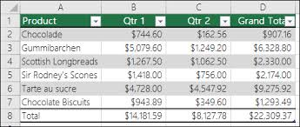
Solution Approach
column headers as in the input CSV file
Pre-requisite
System installed with Python 3.0 , pip3, VS code , pandas (used in Data Science)
Input CSV file
A file of csv format is taken as the input (input.csv)
Column count for Result file
User prompted to choose number of columns required in the result file
Enter Column Headers
User prompted to choose the column headers(header names as in the input CSV file)
Row count for Result file
User prompted to enter number of rows
Result file Generation
Result generated and stored in result.csv

Slide 2

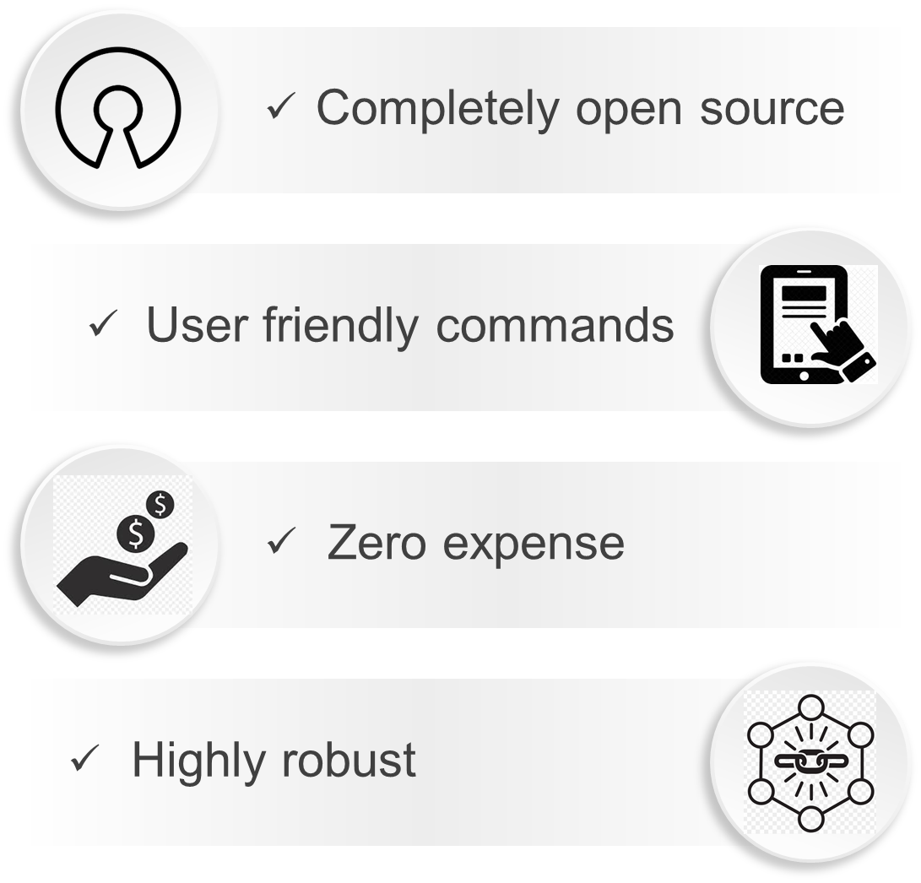
Qualitative and Cost Benefits

Slide 3


Future Enhancements
Prototype can be converted to an online platform
GUI can be provided for smoother user experience
Utility can be fully automated through following methods:
Automatic running of utility on regular intervals →any change in input instance reflects on test result sheet
Change in input instance triggers automatic execution →test result sheet is always in sync with input sheet
Code can be customized to remove any redundant/erroneous data.

